Slide 1
Unmanned Aircraft Systems (UAS)
Update

Slide 2
FAA Vision for UAS Integration
Safe, efficient, and timely integration of UAS into the airspace
Safe
Because safety is the FAA’s primary mission
Efficient
FAA is committed to reduce delays and increase system reliability
Timely
FAA is dedicated to supporting this exciting new technology
Notes:
When UAS Integration Office was started, Jim Williams decided that UAS Integration needed a clear, concise vision statement (see slide).

Slide 3
Getting to Integration
Today
Accommodation
Mid-term
Transition to NAS Integration
Long-term
Integration into the NextGen NAS
Notes:
Up until last year “integration” was all about public (governmental) aircraft accommodation via Certificates of Waiver or Authorization (COA)
However, in August 2012, the FAA received the first civil certification application; once the certification process has been put to the test, modified for UAS, and the first civil UAS is certified, it will open up another avenue for NAS access
Mid term begins integration, which includes:
Releasing and then finalizing the small UAS rule
Implementing NAS Voice System
Standardizing procedures
Long term includes:
Integration of UAS into Next Gen UAS

Slide 4
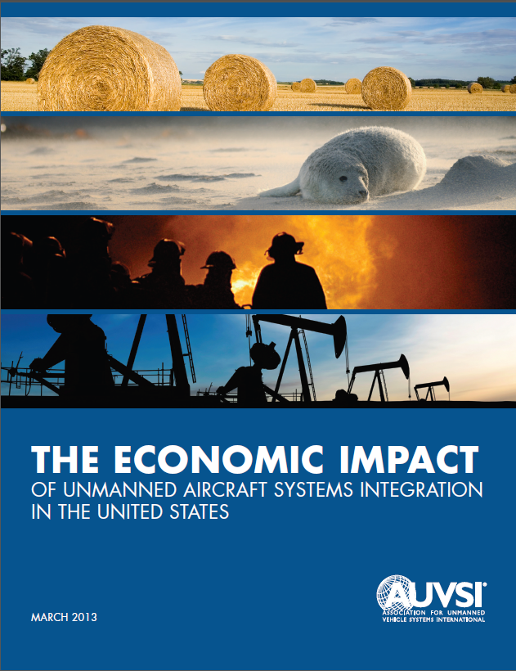
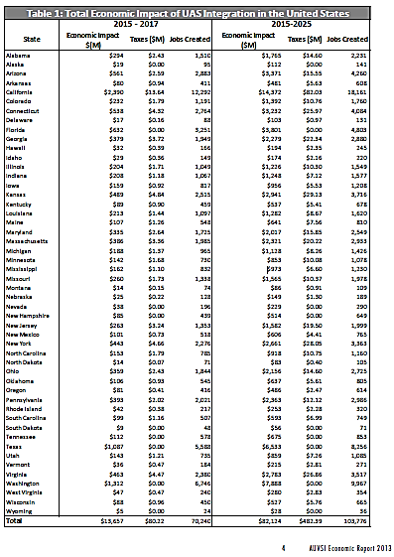
Economic Impact Estimated at $82B with over 100,000 Jobs Created – AUVSI, 2013
Notes:
Precision agriculture and public safety expected to comprise of 90% of UAS markets
Economic impact in the first 3 years: $13.6 billion
Cumulating to more than $82.1 billion 2015-2025
By 2025, total job creation (expected): 103,776
70,000 new jobs expected in first 3 years
States likely to be impacted most:
California
Washington
Texas
Florida
Arizona
Connecticut
Kansas
Virginia
New York
Pennsylvania
Anticipated 150,000 unit sales annually for agricultural purposes at maturity
Potential for 50% growth in first year, additional 5% growth in subsequent years (use in agricultural markets)
Japan year one: 20% growth with no previous knowledge of systems (1990)
U.S. growth expected to mimic Japan
Total projected spending, 2015:
$2,096.5 million ($41,929,742-$61,565,404 expected to agriculture)
Total job creation: 21,565 (431-633 new jobs)
Largest impact California
Direct impact:
$366.9 million ($185,307,769 agriculture)
3,774 new jobs (1,942 agriculture)
Indirect impact:
$85,230,970-$14,302,673 agriculture
102-150 new jobs agriculture
Induced spending:
$96,348,773 agriculture
1,010 new jobs agriculture

Slide 5
Who is Operating UAS in the
National Airspace System (NAS)?*
Public (Governmental) Use Aircraft – via Certificate of Waiver or Authorization (COA)
Department of Agriculture
Department of Commerce
Department of Defense
Department of Energy
Department of Homeland Security
Department of Interior
Department of Justice
NASA
State Universities
Federal/State/Local Law Enforcement
Civil Aircraft – via Special Airworthiness Certificates in the Experimental Category and Special Flight Permits
Raytheon
AAI Corporation
General Atomics
Boeing
Others
Insitu
Aerovironment
* FAA has approved limited small UAS commercial operations in Arctic
Notes:
5
Who is Operating?
COAs
Most operators are US Federal agencies with aviation programs
Department of Defense is a major player
NASA is and operator AND conducts UAS research
Public universities
Law Enforcement
This area is expected to grow significantly
Civil
All experimental airframe manufacturing and testing
2 companies have submitted applications and a third is under consideration (Global Hawk – Large UAS)

Slide 6
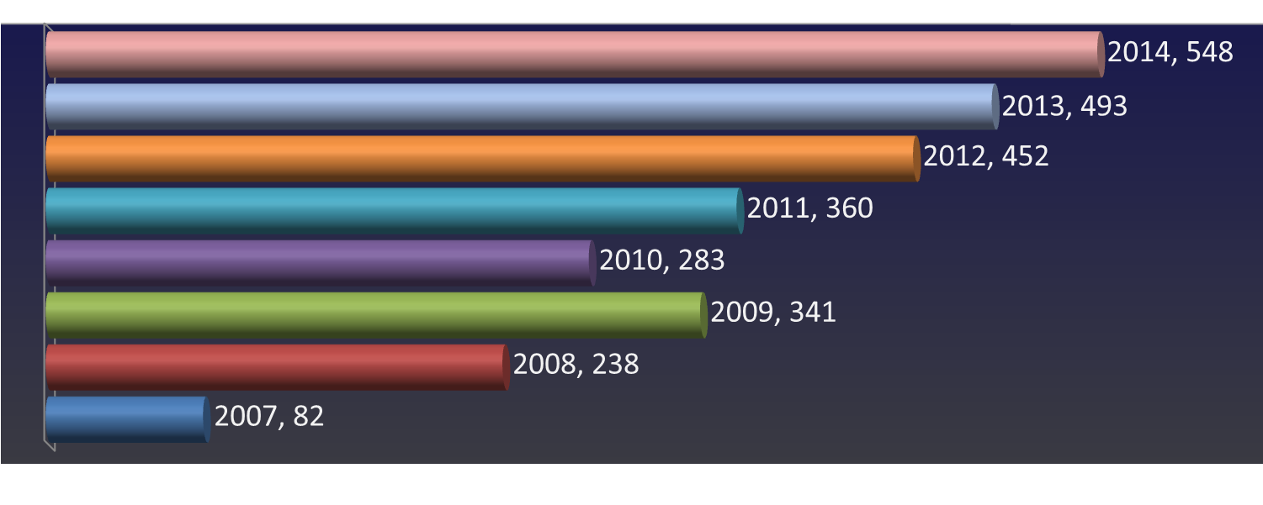
Applications Submitted
COA Applications Submitted
All data as of 8/25/2014

Slide 7
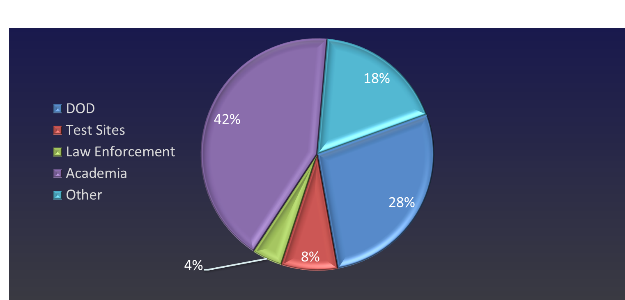
Proponent Breakdown
COA Applications Submitted by Proponent CY14
All data as of 8/25/2014

Slide 8
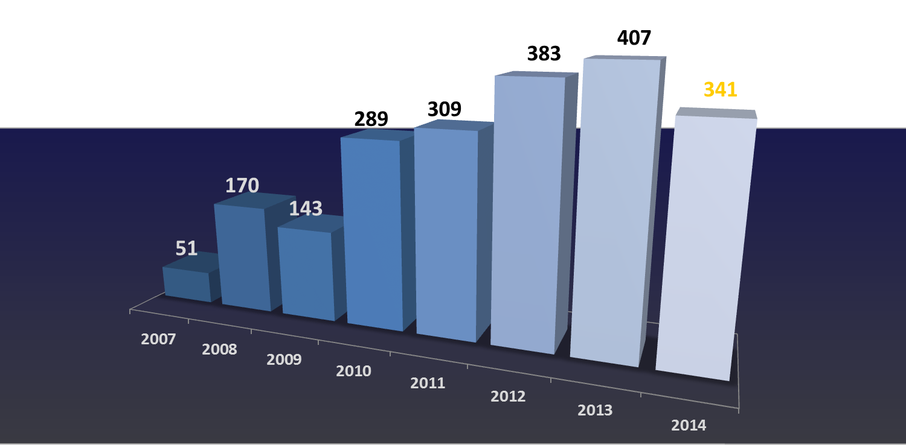
Applications Approved
COA Applications Approved
All data as of 8/25/2014

Slide 9
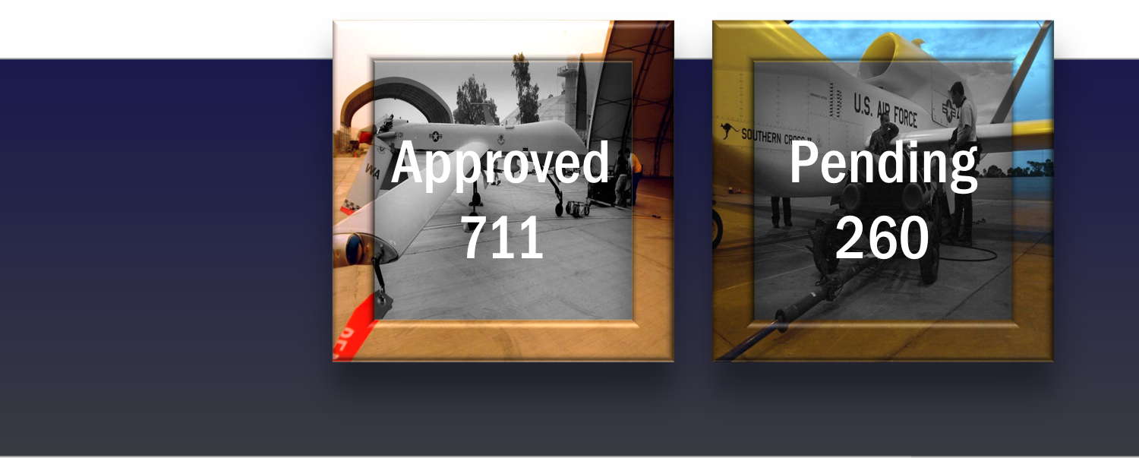
Current Authorizations
Current Authorizations
All data as of 8/25/2014

Slide 10
Test Site Timeline
February 14, 2013: Solicitation for proposals from public entities
  Received 25 applications from 24 states
November 2013: Test site privacy requirements published
December 30, 2013: Test sites awarded
June 28, 2014: First test site must be up and running
  All six test sites are currently operational as of August 13
February 13, 2017: Test sites operations may conclude
June 2017: Final report due to Congress within 90 days of the test site program conclusion

Slide 11
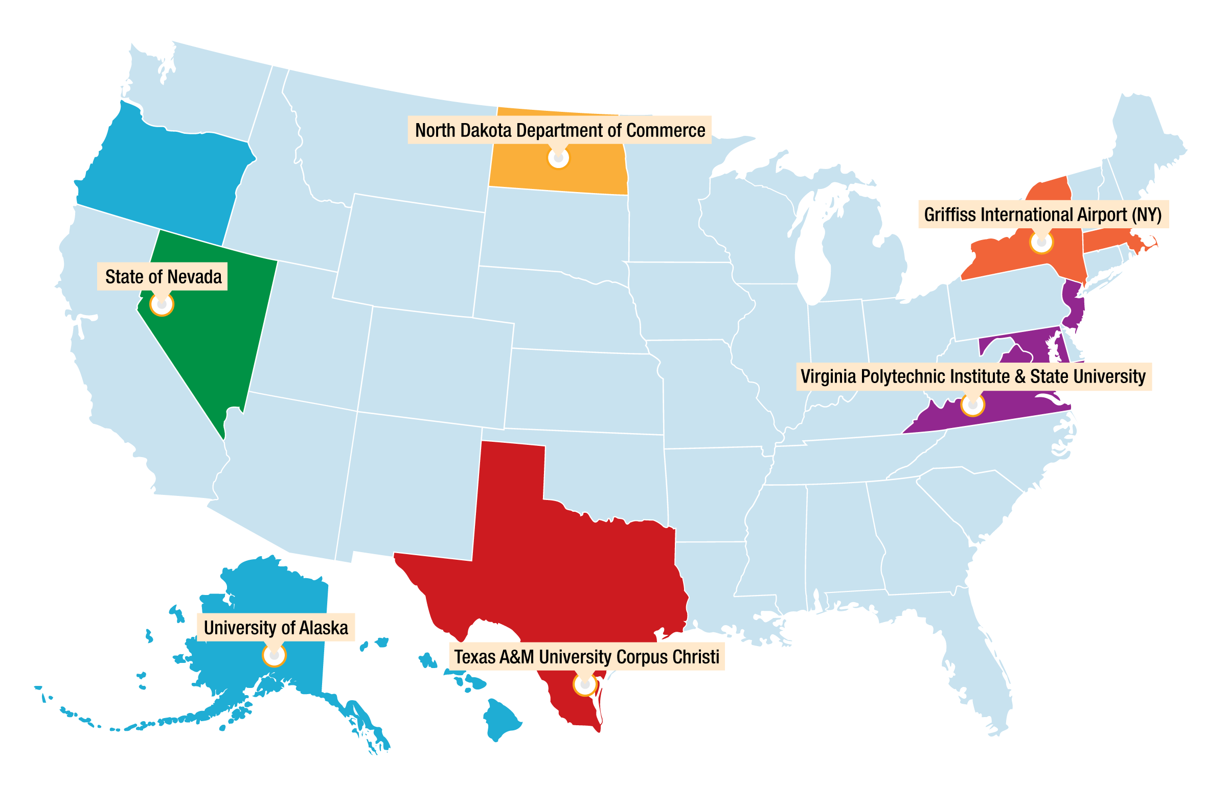
UAS Test Sites
University of Alaska
  Includes test ranges in Hawaii and Oregon
  Operational May 5, 2014
State of Nevada
  Operational June 9, 2014
New York Griffiss International Airport
  Includes test ranges in Massachusetts
  Operational August 7, 2014
North Dakota Department of Commerce
  Operational April 21, 2014
Texas A&M University – Corpus Christi
    Operational June 20, 2014
Virginia Polytechnic Institute and State University (Virginia Tech)
  Includes test ranges in New Jersey (partnered with Rutgers University) and Maryland
  Operational August 13, 2014
Notes:
Post-award conference held with each Test Site
Technical Interchange Meetings – held twice a year
March meeting held at Wm. J. Hughes Technical Center
100 Attendees
2 Days
Next meeting scheduled for September 23-24 at Virginia Tech’s Blacksburg, VA campus
All Test Sites approved for operations and issued COA by August 2014
North Dakota Department of Commerce
COA granted April 21; first flight May 5
2 ½ months ahead of the 180 day FMRA requirement
University of Alaska
COA granted May 4; first flight same day
State of Nevada
COA granted June 9
Texas A&M – Corpus Christi
COA granted June 20
New York Griffiss Airport
COA granted August 7
Virginia Tech
COA granted August 13

Slide 12

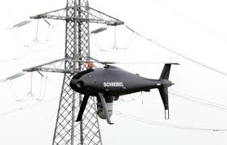


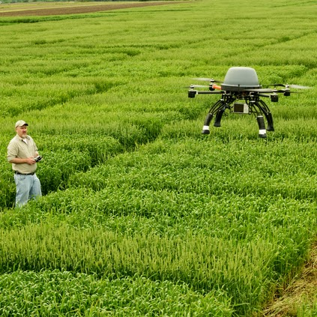

Potential Areas for Section 333
FILMING | POWER LINE INSPECTION | PRECISION AGRICULTURE | FLARE STACK INSPECTION

Slide 13
Section 333 Benefits and Potential Areas
May be able to move forward with incremental UAS integration for specific, limited, low-risk uses in advance of small UAS rule
  Includes commercial operations
  Begins to address demand
  Economic benefits
Exempts Airworthiness requirements
  May apply for additional exemptions, which may or may not be granted
Potential Areas
  Movie making
  Precision agriculture
    Surveillance of crops and livestock
    Application of fertilizer/pesticides
  Flare stack (oil rig) monitoring
  Power line inspection
27 companies have filed Petitions for Exemption based on Section 333 (as of August 20)
Notes:
Applicants include (as of August 20):
Astraeus Aerial (film and television)
Aerial MOB, LLC (film and television)
HeliVideo Productions, LLC (film and television)
Flying-Cam, Inc. (film and television)
RC Pro Productions Consulting LLC d/b/a Vortex Aerial (film and television)
Pictorvision, Inc. (film and television)
Snaproll Media, LLC (film and television)
Trimble Navigation, Limited (aerial surveys)
VDOS Global, LLC (flare stack inspections for Shell Oil)
Yamaha Motor Corporation, USA (agricultural; RMAX helicopter)
Woolpert, Inc. (aerial surveying)
Amazon.com (delivery system – research and development)
Douglas Trudeau (community awarness/real estate)
Woolpert, Inc. (aerial acquisitions in Ohio)
Clayco, Inc. (aerial imaging – construction)
Advanced Aviation Solutions, LLC (photogrammetry and crop scouting)
Burnz Eye View, Inc. (aerial photography/inspection)
CAVU Media, LLC (film and television)
Slugwear, Inc. dba Likeonalemontree Aerial (aerial photography and survey)
MicroCopter Professional Services, Inc. (aerial filming and inspection)
Vision Services Group, LLC (data collection)
Utility Aerial Services, Inc. (utility-power generation inspections and patrol)
Network Media Services, LLC DBA Applied Drone Technologies (film and television; R&D for law enforcement, first responders, search and rescue)
Wilbur-Ellis Co. (agriculture survey and inspection)
Total Safety, U.S. (pipeline/flare stack inspection)
Colin Hinkle (photography)
Montico, Inc. (telecommunications tower inspection)

Slide 14
Small UAS Rule
Key initiative for introducing commercial UAS operations safely into the NAS
  Plan to release Notice of Proposed Rulemaking (NPRM) in late 2014
  Small commercial UAS projected to be largest growth sector
  Strategic initiative and Administrator’s priority
Notes:
NPRM later this year
Will address largest commercial demand
Until it is out, all (except Arctic) commercial uses illegal
Test sites excepted (R&D)
Possible exemption for movies/TV but not final yet

Slide 15
Raphael Pirker Case
Background
  Raphael Pirker fined $10,000 for “reckless and careless” operation of a model UAS following filming at the University of Virginia, 2011
Legal Actions
  National Transportation Safety Board (NTSB) judge dismissed case on March 6, 2014
  FAA appealing decision to full NTSB panel
    Judge’s decision stayed, pending NTSB review
Impact
  Increased media reports of unauthorized commercial operations and comments from operators in the media who say they plan to operate without FAA authorization
Response
  Interpretive Rule issued on June 23
    Restates FAA authority to take enforcement action against hazardous operations
Notes:
Describe incident
Based on FRN and AC fined $10k for “careless and reckless”
Compliance is FAA objective and NOT enforcement
Refused to comply and cease operations
Appealed the fine to NTSB ALJ
Won the case based on lack of specific UAS rules and judge agreed was model aircraft
Some press reports stated FAA has no jurisdiction
Could not be further from true but reports of UAS flying near airports have spiked (1-2/month to 4-6/month)
June 23 FAA published our response

Slide 16
Interpretive Rule
FAA published guidance after recent incidents involving the reckless use of unmanned model aircraft near airports and involving large crowds of people
FAA issued the notice to provide clear guidance to model operators on the “do’s and don’ts” of flying safely in accordance with the 2012 FAA Reauthorization Act and to answer questions regarding the scope and application of the rules
Clarifies:
  Model aircraft must satisfy the criteria in the Act to qualify as model aircraft and to be exempt from future FAA rulemaking action
  Consistent with the Act, if a model aircraft operator endangers the safety of the NAS, the FAA has the authority to take enforcement action against those operators for safety violations
Posted to Federal Register on June 23; public comment period produced more than 30,000 comments
https://www.federalregister.gov/articles/2014/06/25/2014-14948/interpretation-of-the-special-rule-for-model-aircraft
Notes:
Not a new regulation – interpreting the language of section 336 so that everyone will have a common understanding of the law and existing rules
Strictly for hobby or recreation – no business or financial gain
Must gain permission from ATC when flying within 5 miles of an airport
Flying over the objection of ATC or airport operators considered endangering the safety of the NAS
FAA expects modelers to know the FAA’s existing safety regulations – intended to prevent endangerment to safety
Does not limit the FAA’s authority to take enforcement action against those who endanger the safety of the NAS
FAA will investigate reported incidents and determine if enforcement is necessary
Goal to make sure inspectors give standard information on how to comply with regulations

Slide 17
Interpretive Rule
Outlines:
  Background of FAA Oversight in Model Aircraft Operations
    AC 91-57: Model Aircraft Operation Standards
    2007 Federal Register Notice – Clarification of AC 91-57
  Requirements to Qualify as a Model Aircraft Under the FAA Modernization and Reform Act of 2012 (Pub. L. 112-95, Section 336)
    Statutory Requirements
    Model Aircraft Must Meet the Criteria in Section 336 to be Exempt from Future Rulemaking
  Scope of the FAA’s Enforcement Authority
    “nothing in this section shall be construed to limit the authority of the Administrator to pursue enforcement action against persons operating model aircraft who endanger the safety of the national airspace system.” (Pub. L. 112-95, Section 336(b))
  Examples of Regulations that Apply to Model Aircraft
    How the aircraft is operated
    Operating rules for designated airspace
    Special restrictions such as temporary flight restrictions (TFRs) and notices to airmen (NOTAMs)

Slide 18
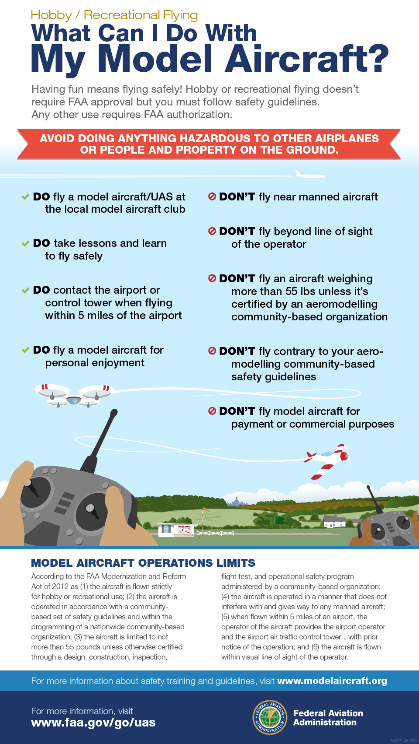
Education, Compliance and Enforcement
Interpretive Rule Communication Plan
  Immediate Actions
    Press release/infographic
    Guidance for Aviation Safety Inspectors and Air Traffic Control
    Law enforcement outreach
  Follow-on Actions
    Continued partnership with Academy of Model Aeronautics (AMA)
    Establish partnerships with:
      Other agencies
      Manufacturers/industry
http://www.faa.gov/about/initiatives/uas/model_aircraft_operators/

Slide 19
Education, Compliance and Enforcement
Defines authorized vs. unauthorized operations
  Authorized operations require: Certificate of Waiver or Authorization (COA), Airworthiness Certification, Issuance of Exemptions
  Model Aircraft operations, as defined in Section 336(c) of the FMRA, as strictly for hobby or recreation purposes
Outlines actions for persons who operate:
  UAS in violation of the Federal Aviation Regulations (FARs)
  Model Aircraft that endanger the safety of the NAS
Notice to Inspectors issued regarding how to use the Interpretive Rule (Notice 8900.268)
Compliance and Enforcement Bulletin being published

Slide 20
UAS Center of Excellence
Originally suggested in Senate committee report in FY 2012
In FY 2013, FAA received several Congressional inquires
  FAA deferred selection process until UAS Test Site selection complete
Included as requirement in FY 2014 Transportation, Housing and Urban Development (THUD) conference report
Selection process to start later this year and award in FY 2015
  Public announcement March 28, 2014
  Public meeting held May 28,2014
  Final Solicitation issued August 12, 2014
    Closing date for responses September 15, 2014

Slide 21
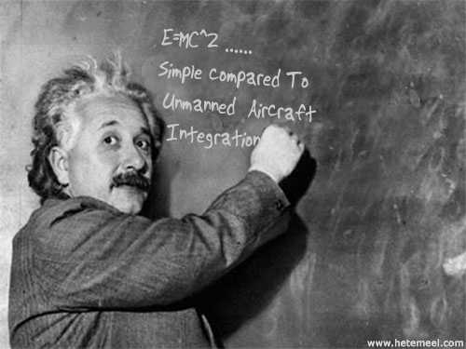
Questions?

Slide 22
Backup

Slide 23
Section 333. Special Rules for Certain Unmanned Aircraft Systems
(a) SECTION 333 – Notwithstanding any other requirement of this subtitle, and not later than 180 days after the date of enactment of this Act, the Secretary of Transportation shall determine if certain unmanned aircraft systems may operate safely in the national airspace system before completion of the plan and rulemaking required by section 332 of this Act or the guidance required by section 334 of this Act.
(b) ASSESSMENT OF UNMANNED AIRCRAFT SYSTEMS – In making the determination under subsection (a), the Secretary shall determine, at a minimum:
  (1) which types of unmanned aircraft systems, if any, as a result of their size, weight, speed, operational capability, proximity to airports and populated areas, and operation within visual line of sight do not create a hazard to users of the national airspace system or the public or pose a threat to national security; and
  (2) whether a certificate of waiver, certificate of authorization, or airworthiness certification under section 44704 of title 49, United States Code, is required for the operation of unmanned aircraft systems identified under paragraph (1).
(c) REQUIREMENTS FOR SAFE OPERATION – If the Secretary determines under this section that certain unmanned aircraft systems may operate safely in the national airspace system, the Secretary shall establish requirements for the safe operation of such aircraft systems in the national airspace system.
Notes:
Given the flexibility provided for by this statute, operators may petition for exemption from regulations mandated by Title 14 of the Code of Federal Regulations.

